Slide 1
Regression Tree
Credit: https://www.youtube.com/watch?v=g9c66TUylZ4

Slide 2
Let’s see an example
Let's say that we have developed a new drug to cure COVID-19.
However, we do not know the optimal dosage.
So, we conduct a clinical trial to collect data on the drug's effectiveness.

Slide 3
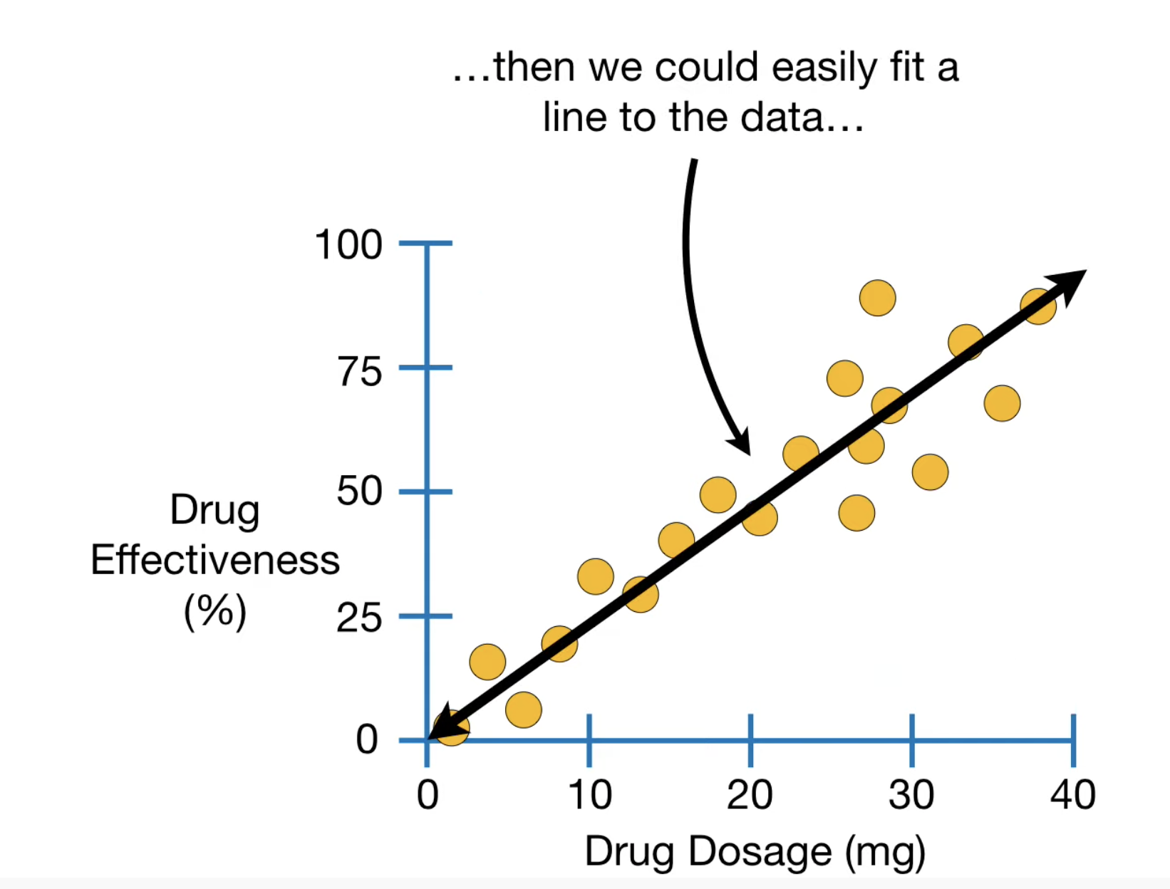

Slide 4
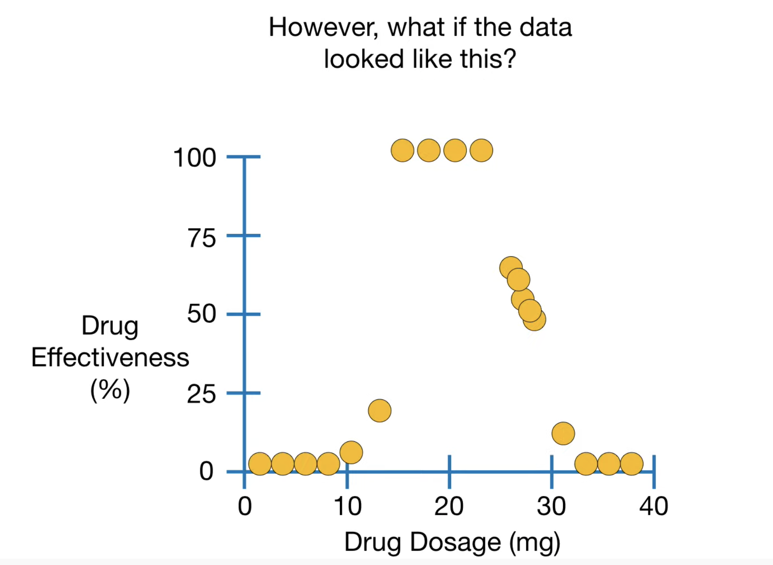

Slide 5
